Slide 1


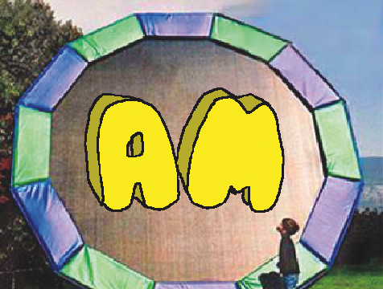


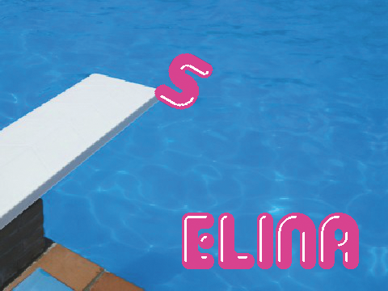


Animate a Name Cards
Animate the letters of your name, initials, or favorite word.
yyyymmdd
scratch.mit.edu
1
Set of 7 cards

Slide 2

Animate a Name Cards
Try these cards in any order:
Color Clicker
Spin
Play a Sound
Dancing Letter
Change Size
Press a Key
Glide Around
scratch.mit.edu
2
Set of 7 cards

Slide 3





Color Clicker
Make a letter change color when you click it.
yyyymmdd
Animate a Name
1
3

Slide 4


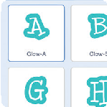

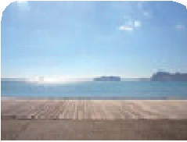

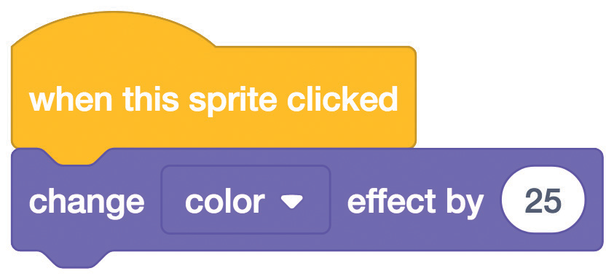

Color Clicker
scratch.mit.edu
GET READY
Choose a letter from the Sprite Library.
Choose a backdrop.
Boardwalk
To see just the letter sprites, click the Letters
category at the top of the Sprite Library.
ADD THIS CODE
Try different numbers.
TRY
Click your letter.

Slide 5




Spin
Make a letter turn when you click it.
yyyymmdd
Animate a Name
2

Slide 6
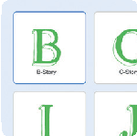

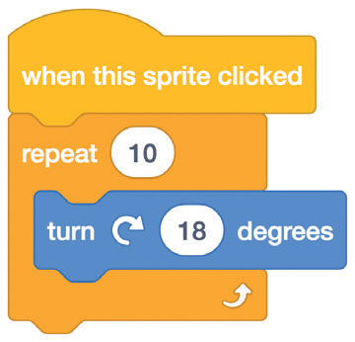

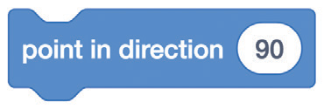
Spin
scratch.mit.edu
GET READY
Go to the Sprite Library.
Click the Letters
category.
Choose a letter sprite.
ADD THIS CODE
Try different numbers.
TRY IT
Click your letter.
TIP
Click this block to reset the sprite’s direction.

Slide 7

Play a Sound
Click a letter to play a sound.
yyyymmdd
Animate a Name
3

Slide 8
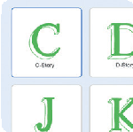


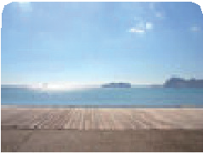


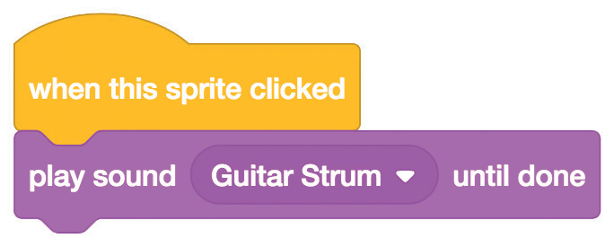

Play a Sound
scratch.mit.edu
GET READY
Go to the Sprite Library.
Click the Letters
category.
Choose a letter sprite.
Click the Sounds tab.
Choose a backdrop.
Boardwalk
Choose a sound.
ADD THIS CODE
Click the Code tab.
Choose a sound from the menu.
TRY IT
Click your letter.

Slide 9
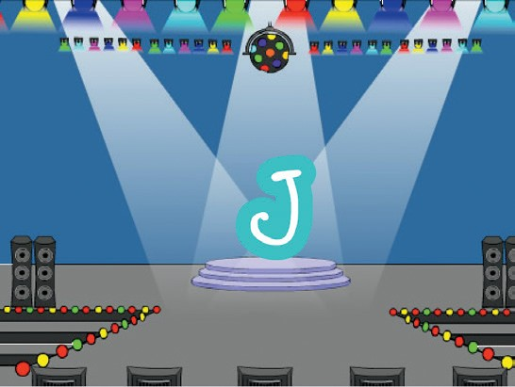
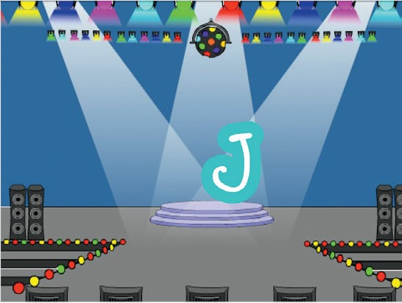
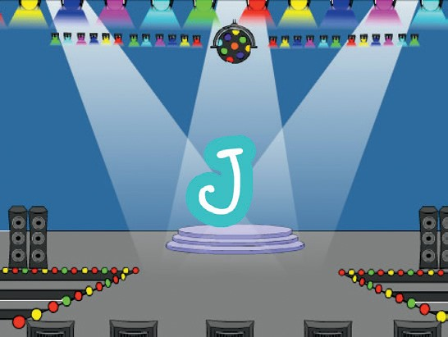
Dancing Letter
Make a letter move to the beat.
yyyymmdd
Animate a Name
4

Slide 10

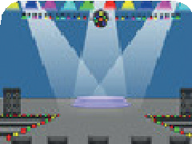
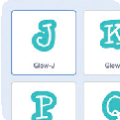

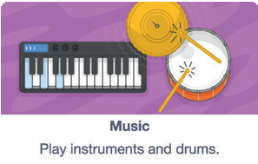
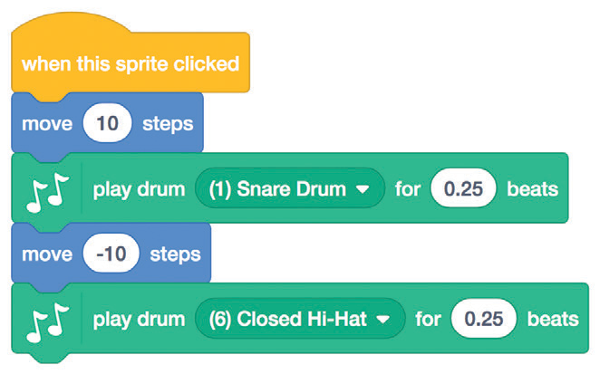

Dancing Letter
GET READY
scratch.mit.edu
Choose a backdrop.
Spotlight
Choose a letter from the Sprite Library.
Click the Extensions button (at the bottom left).
Then click Music to add the music blocks.
ADD THIS CODE
Type a minus sign to move backward.
Choose a different drum from the menu.
TRY IT
Click your letter.

Slide 11
Change Size
Make a letter get bigger and then smaller.
yyyymmdd
Animate a Name
5

Slide 12
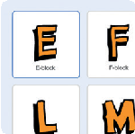

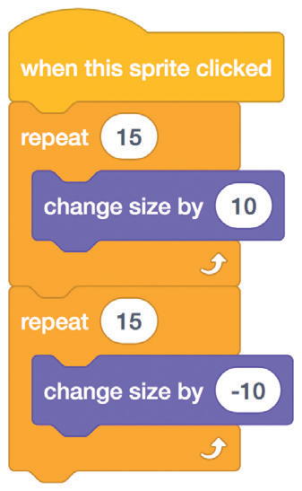
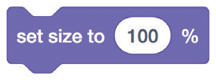
Change Size
scratch.mit.edu
scratch.mit.edu
GET READY
Go to the Sprite Library.
Click the Letters
category.
Choose a letter sprite.
ADD THIS CODE
Type a minus sign to get smaller.
TRY IT
Click your letter.
TIP
Click this block to reset the size.

Slide 13
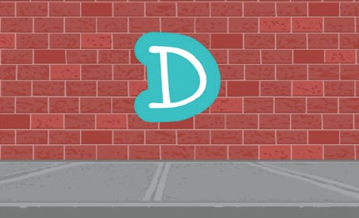
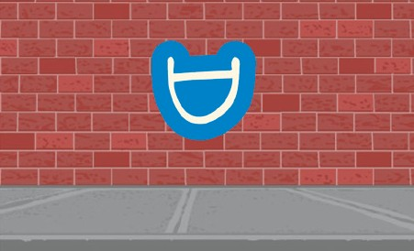
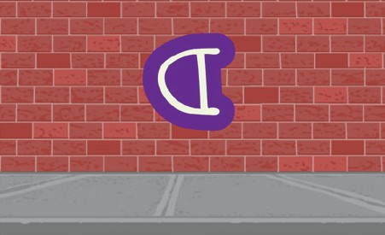

Press a Key
Press a key to make your letter change.
yyyymmdd
Animate a Name
6

Slide 14
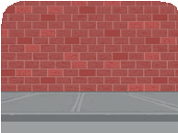
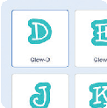
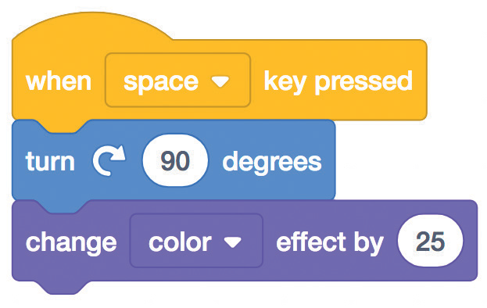
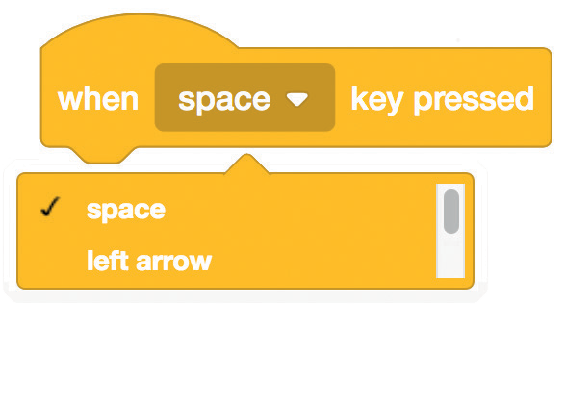
Press a Key
scratch.mit.edu
scratch.mit.edu
GET READY
Choose a backdrop.
Wall 1
Choose a letter from the Sprite Library.
ADD THIS CODE
Try different numbers.
TRY IT
Press the space key.
TIP
You can choose a different key from the menu. Then press that key!

Slide 15



Glide Around
Make a letter glide smoothly from place to place.
yyyymmdd
Animate a Name
7

Slide 16

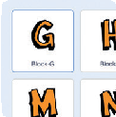
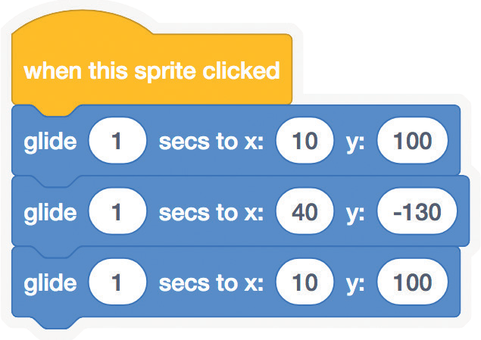

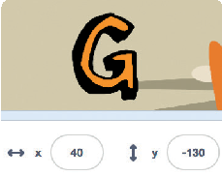
Glide Around
scratch.mit.edu
scratch.mit.edu
GET READY
Choose a backdrop.
Jurassic
Choose a letter from the Sprite Library.
ADD THIS CODE
Try different numbers.
TRY IT
Click your letter to start.
TIP
When you move a sprite, you can see the numbers for x and y update.
x is the position from left to right.
y is the position up and down.

